Slide 1


Interpretation of the Climate Aspects and Indices
discussed during the WMO RA-III/IV
Regional Focus Monthly Sessions
José Manuel Gálvez ¹, Michel Davison² and Bernie Connell³
1. Systems Research Group Inc. for WPC / NWS / NOAA
2. Weather Prediction Center (WPC) / NWS / NOAA
3. Cooperative Institute for Research in the Atmosphere (CIRA) / CSU / NOAA
10 February 2021

Slide 2
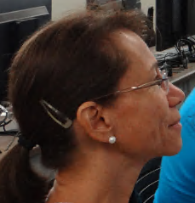
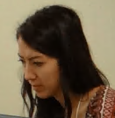
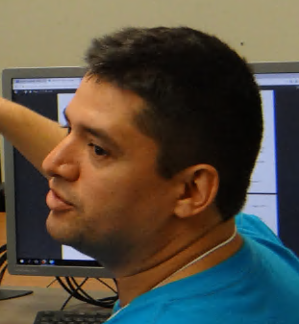
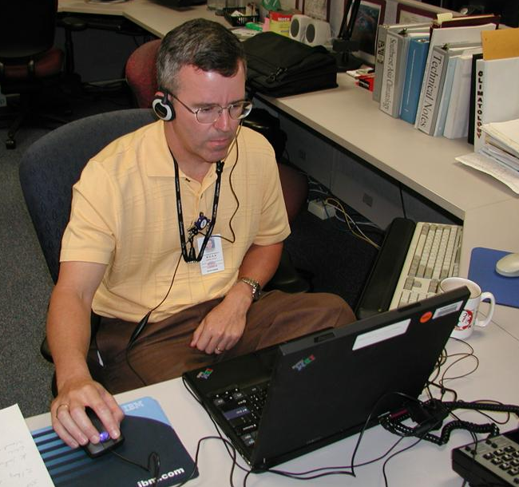
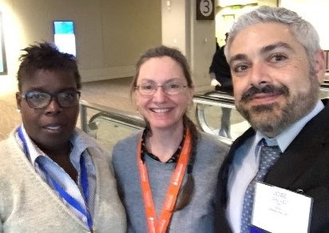
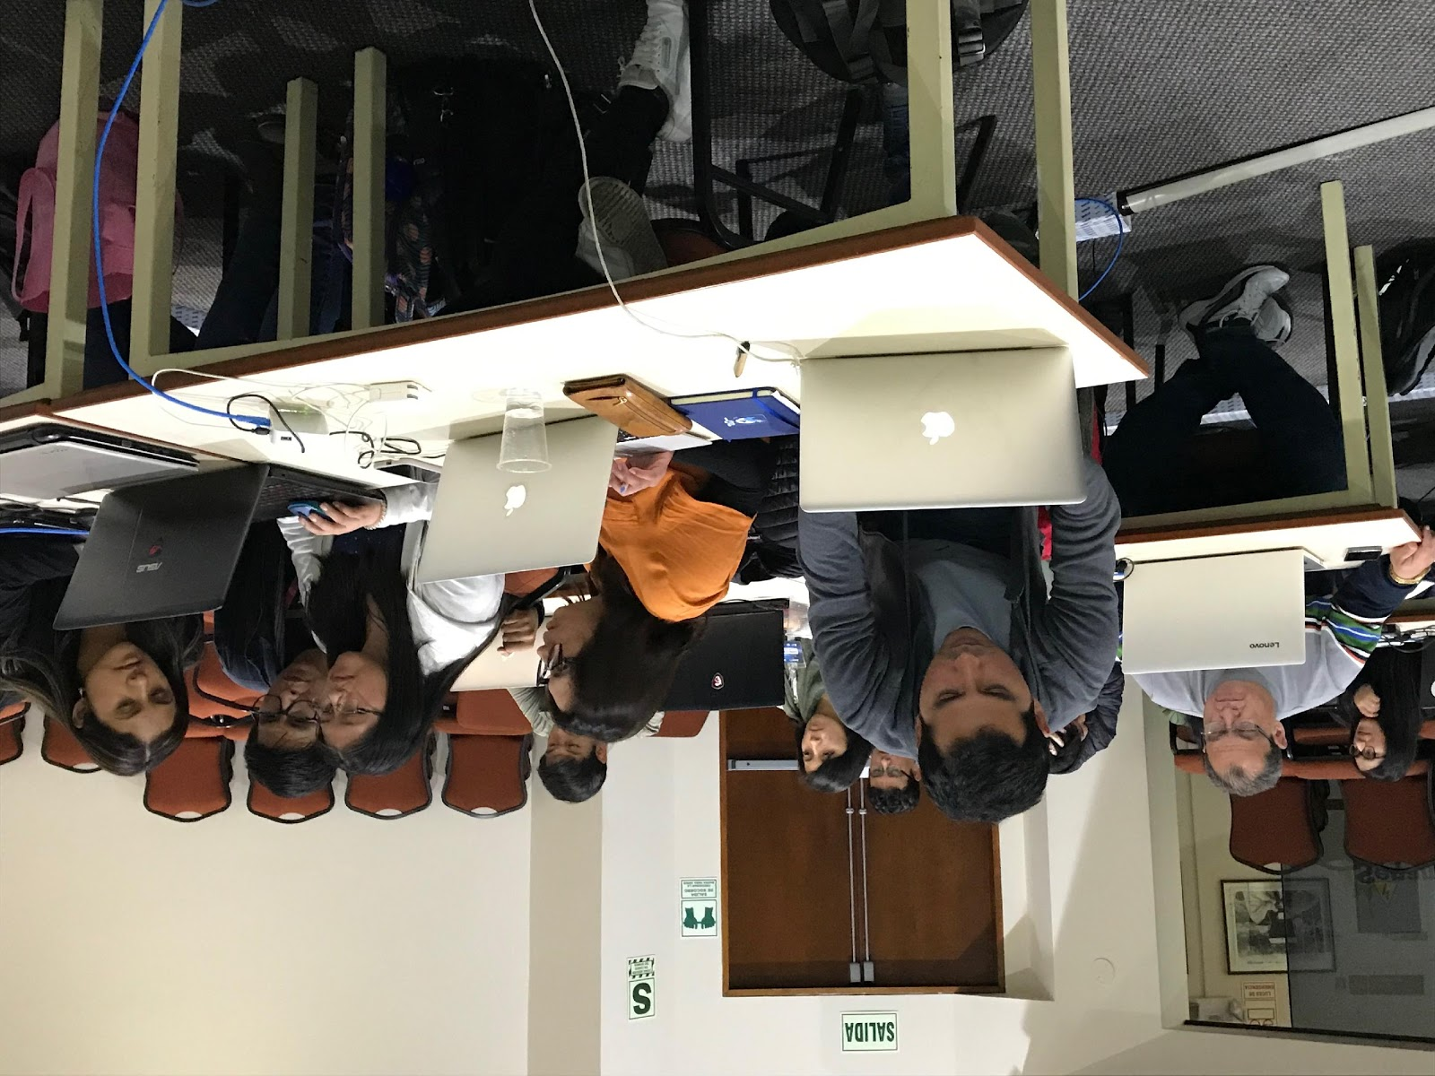
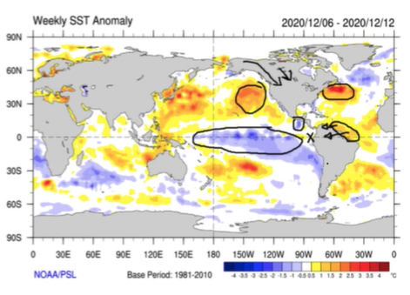
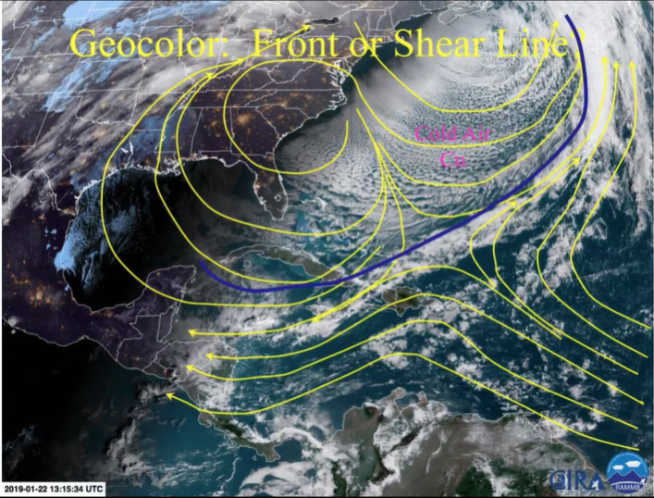
WMO RA III-IV Regional Focus Group
Since March 2004, the group conducts virtual monthly weather and climate discussions for the Americas and the Caribbean.
Collaborative effort: CIRA, the WPC International Desks, the CIMH (Barbados), the University of Costa Rica, SMN Argentina and the Space Agency in Brazil.
Bilingual: English and Spanish
Notes:
Our Regional Focus Group conducts virtual monthly weather and climate discussions for the Americas and the Caribbean. It is a collaborative effort among many organizations, two in the US at CIRA and the NWS NCEP WPC International Desks, and four Centers of Excellence in our hemisphere: the CIMH in Barbados, the University of Costa Rica in Costa Rica, the National Meteorological Service of Argentina, and the Space agency in Brazil. The sessions are bi-lingual, presented in English and Spanish, and were initiated in March of 2004. They are inclusive in many ways, crossing many political and social boundaries.

Slide 3
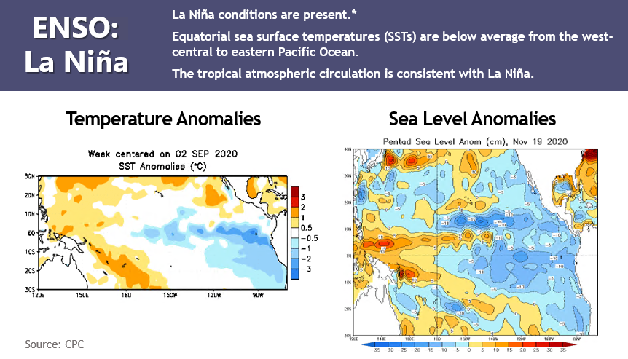
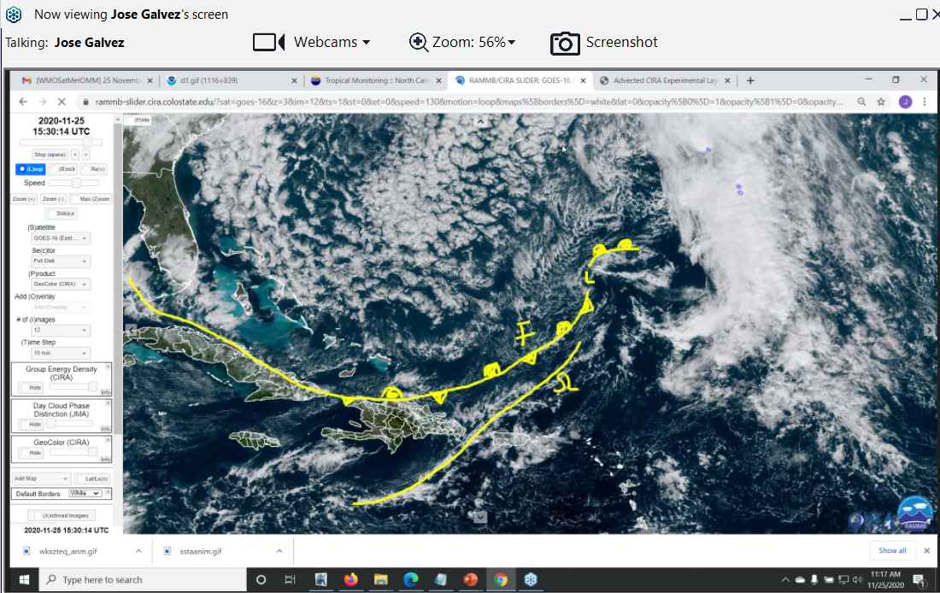
The Monthly Sessions
A typical session includes:
Climate overview (Climate Aspects and Indices)
Discussion of current weather
Review of significant weather events that occurred during the past month
Participant input on local and regional weather, and questions.

Slide 4
Outline of Today’s Presentation
Review of some of the Climate Aspects and Indices
  Sea Surface Temperatures and Anomalies
  El Niño – Southern Oscillation (ENSO)
  The Madden Julian Oscillation and Other Equatorial Perturbations – NCICS Web

Slide 5
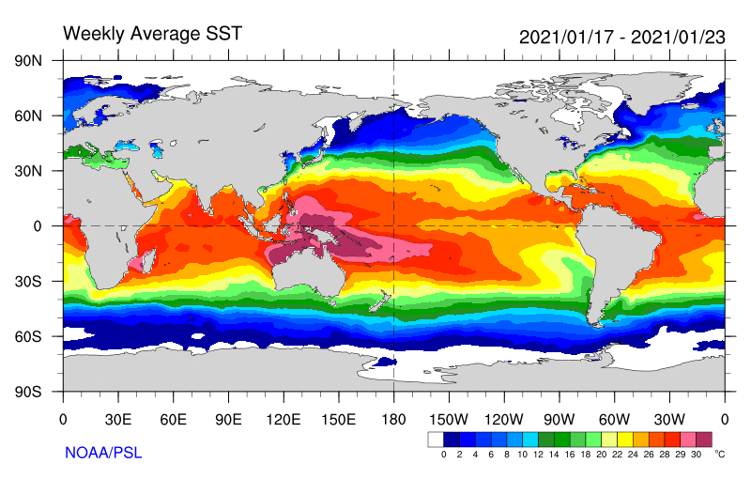
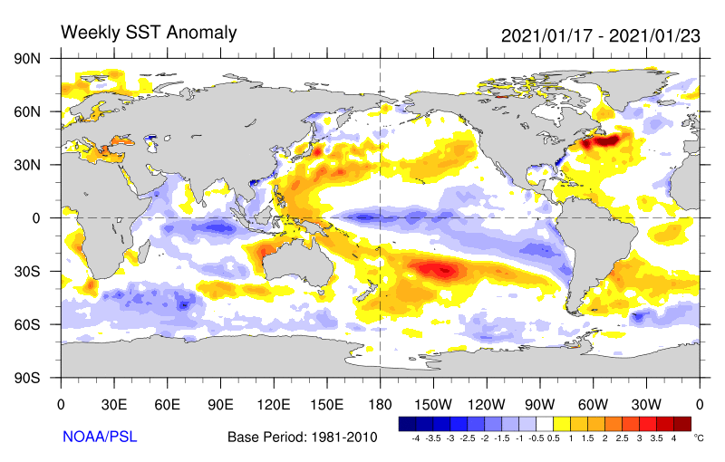
Sea Surface Temperatures and Anomalies
Every session, we start with looking at sea surface temperatures and anomalies
Why is this important?
Source: https://psl.noaa.gov/map/clim/sst.shtml

Slide 6
Sea Surface Temperatures (SST) and Anomalies
Importance
Oceans cover most of the world, they have a strong influence on the weather and climate.
Essential sources of heat and moisture.
Ocean temperatures vary slowly, due to the high specific heat of water C_{P} (water warms and cools much slower than the air and terrain).
Slow-changing ocean temperatures are very useful for sub-seasonal and climate forecasting.

Slide 7
SST effects in the lower troposphere
SSTs affect temperatures, pressures and circulations in the lower troposphere
Ridge
Trough
H
L
Enhanced Divergence
Enhanced Convergence
Cool
Warm
Example: Migration/formation of the ITCZ during periods of weak synoptic forcing.

Slide 8
SST effects in the upper troposphere
In the upper troposphere, the effect is opposite and tends to shift downstream.
Convection connects the lower and upper troposphere.
Upper Trough
Upper Ridge
Cool
Warm

Slide 9
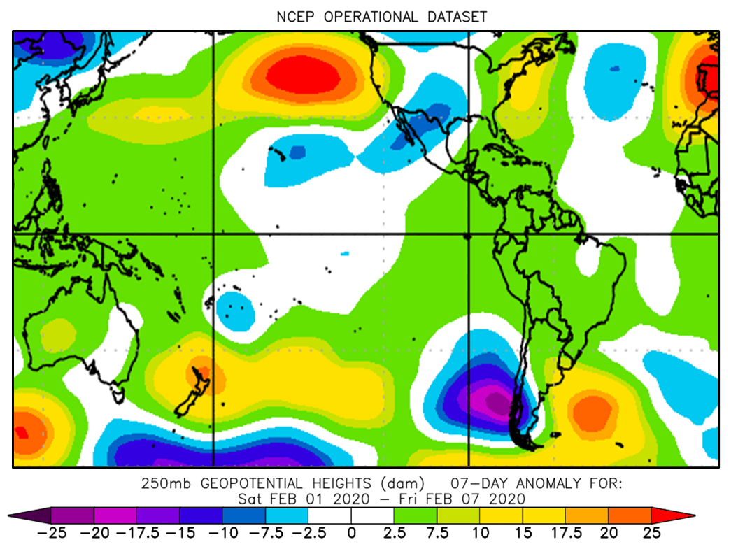
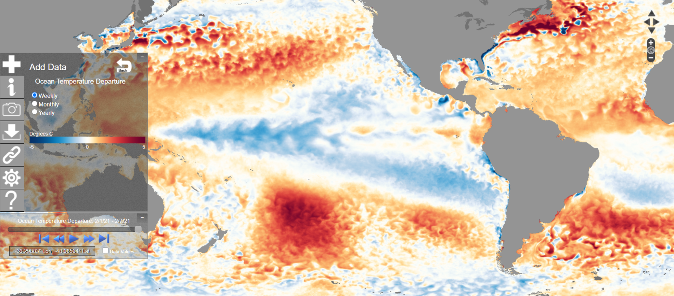
Where are anomalous troughs and ridges favored?
Over/downstream from SST anomalies.
Still, synoptic variability in the extratropics will sometimes overwhelm the influence of SST and anomalies.

Slide 10
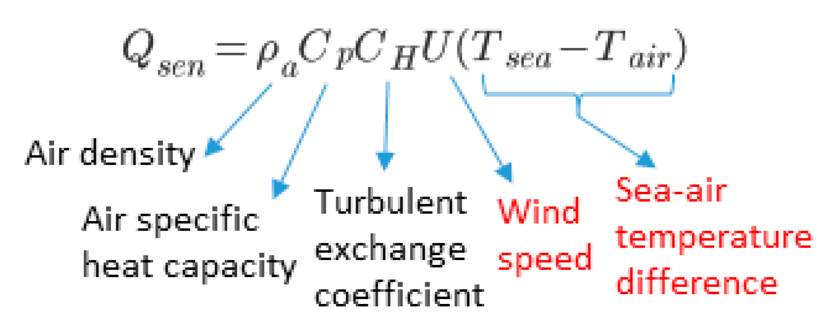
How is sensible heat extracted from the ocean?
Heat flows from (to) the ocean by winds, when SSTs are warmer (cooler) than air
Q_{sen}
Q_{sen}
Q_{sen}
24C
24C
14C
A
B
C
25C
28C
25C
25C
28C
25C
25C
28C
25C
Similarly for moisture, the stronger the wind and drier the air mass, the larger the amounts of moisture extracted.

Slide 11
Which situation is the most unstable?
For instability: evaluate the largest decrease of temperature with height
24C
24C
14C
A
B
C
25C
28C
25C
25C
28C
25C
25C
28C
25C

Slide 12
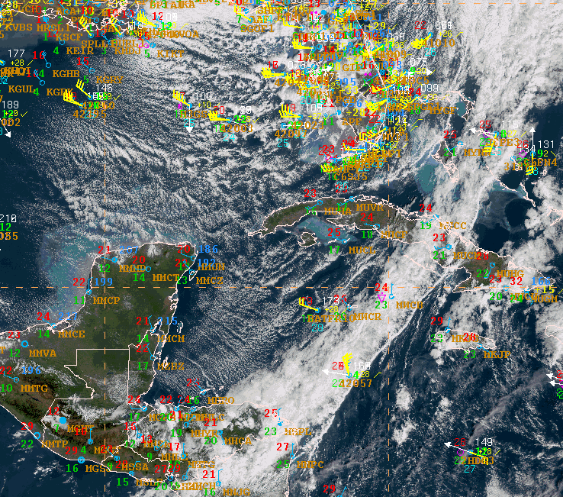
Cold air cumulus
14C
Cold Air Cu
C
25C
28C
25C
Cold Air Cu
Following frontal passage, cold air advection over warmer waters favors convective instability. This triggers post frontal “cold air cumulus”
(Moderate Cu and Cu Congestus)

Slide 13
Strong winds can cool the ocean
Turbulent Mixing with cooler water
Ekman pumping (equator, coasts)
Temperature of underlying layer matters
This is why we look into temperature anomalies in a layer as well
t=1
t=2

Slide 14
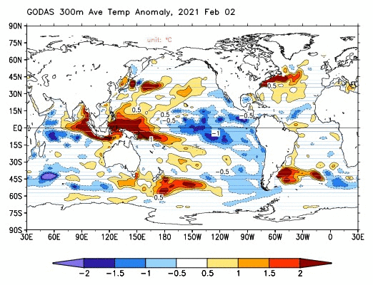
Strong winds can cool the ocean
This is why we look into temperature anomalies in a layer as well
Deeper anomalies will take longer to dissipate. This is crucial for tropical cyclone strengthening

Slide 15
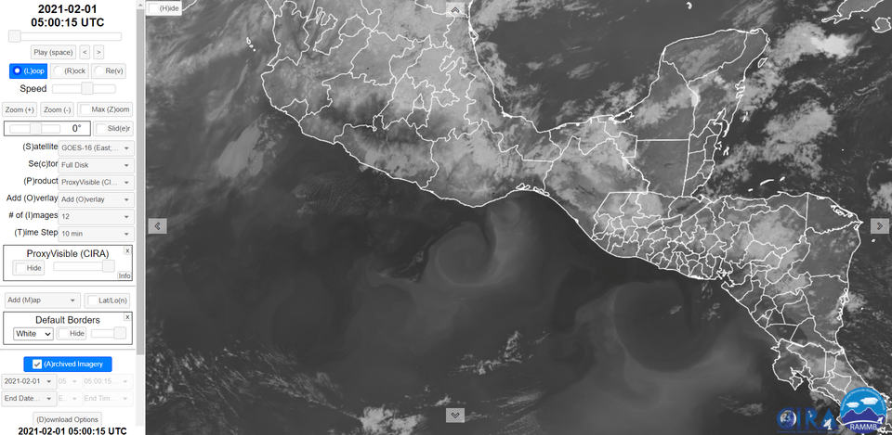
SST: Upwelling inhibits convection
Upwelling from Tehuantepecer Low-level Jet
Upwelling from Papagayo Low-level Jet
Convection forms downstream from / over warmer SSTs

Slide 16
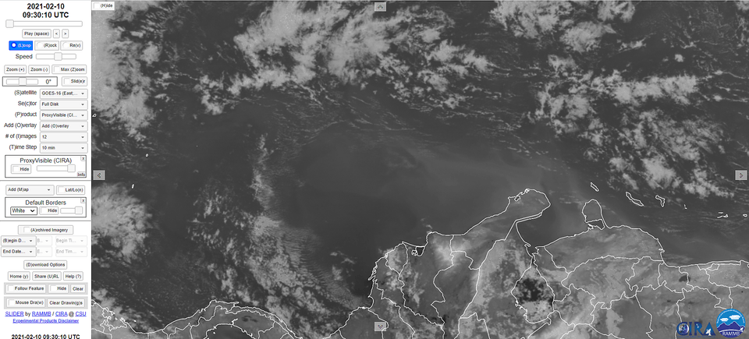
SST: Upwelling inhibits convection
LLJ
Venezuela
Colombia

Slide 17
Importance of anomalies

Slide 18
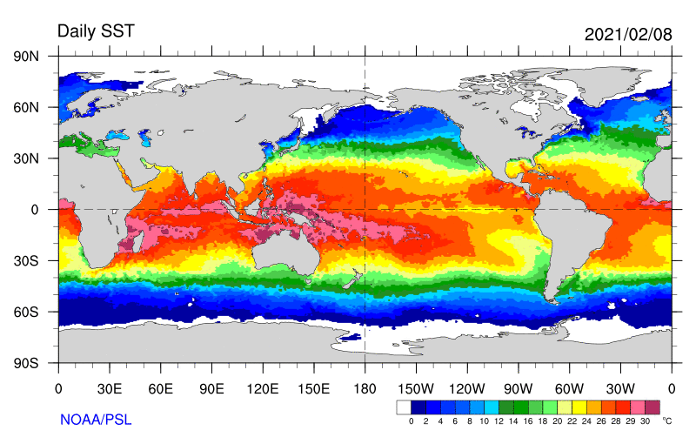
Current SST and Anomalies: Discussion

Slide 19
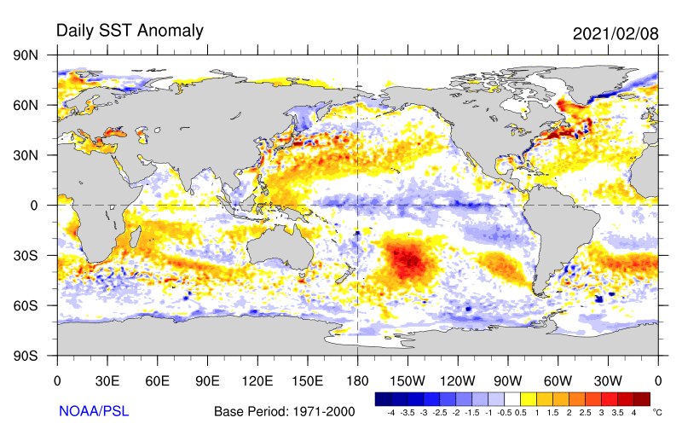
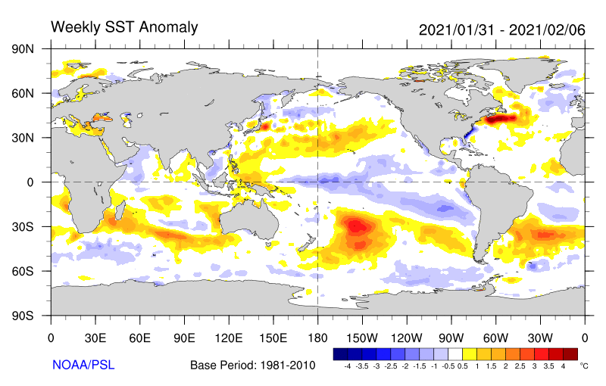
Current SST and Anomalies: Discussion

Slide 20
Current SST and Anomalies: Discussion

Slide 21
SST Resources
SST and anomalies, NOAA PSL: https://psl.noaa.gov/map/clim/sst.shtml
Layer Anomalies, CPC GODAS: https://www.cpc.ncep.noaa.gov/products/GODAS/
Other links:
NOAA OSPO SST (Office of Satellite and Product Operations): https://www.ospo.noaa.gov/Products/ocean/sst/contour/
NOAA OSPO SST Anomalies (Office of Satellite and Product Operations): https://www.ospo.noaa.gov/Products/ocean/sst/anomaly/index.html
NOAA NNVL SST Optimal Interpolation SST (OISST) Anomalies: https://www.nnvl.noaa.gov/view/globaldata.html#SSTA
GHRSST (Group for High Resolution Sea Surface Temperature): https://www.ghrsst.org/latest-sst-map/
OSTIA (Operational Sea Surface Temperature and Ice Analysis), from the Met Office : http://ghrsst-pp.metoffice.gov.uk/ostia-website/index.html
NOAA Star Ocean Color Research Team – OCView: https://www.star.nesdis.noaa.gov/socd/mecb/color/ocview/ocview.html

Slide 22
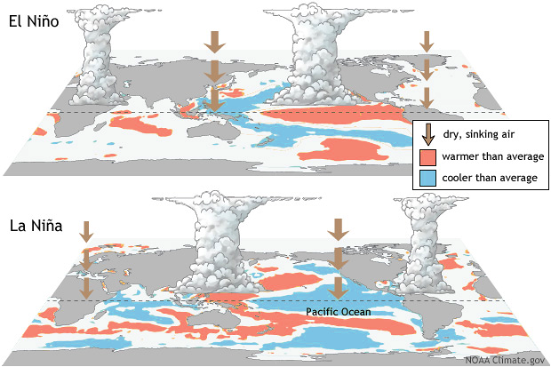
El Niño-Southern Oscillation (ENSO)
Definition
ENSO is a recurrent climate pattern across the Tropical Pacific.
Consists of changes in many oceanic and atmospheric variables that persist during several months.
Has 3 phases: El Niño (warm), La Niña (cool) and neutral.
Source: Climate.gov

Slide 23
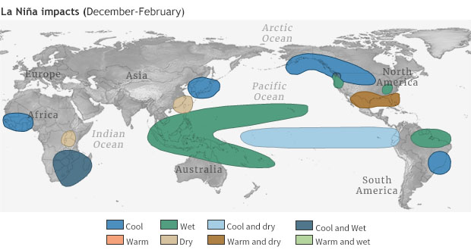
El Niño-Southern Oscillation (ENSO)
Great tool for Seasonal Forecasting around the Globe
ENSO has the ability to change the global atmospheric circulation, influencing temperature and precipitation globally.
Excellent tool for seasonal forecasting, as we can predict ENSO’s arrival many seasons in advance.
Source: Climate.gov
Notes:
https://www.climate.gov/enso

Slide 24
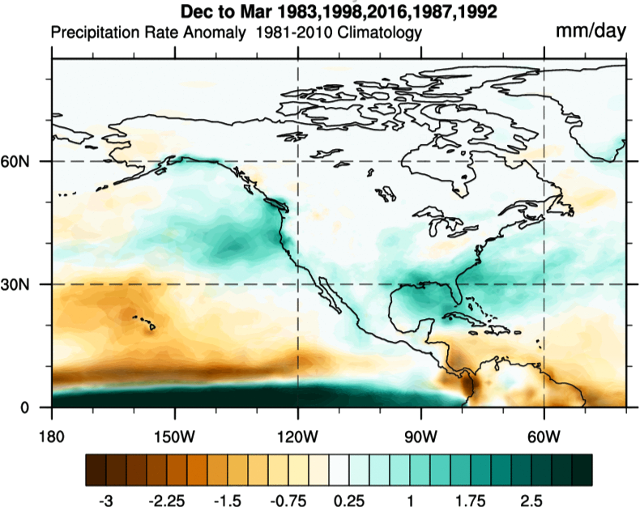
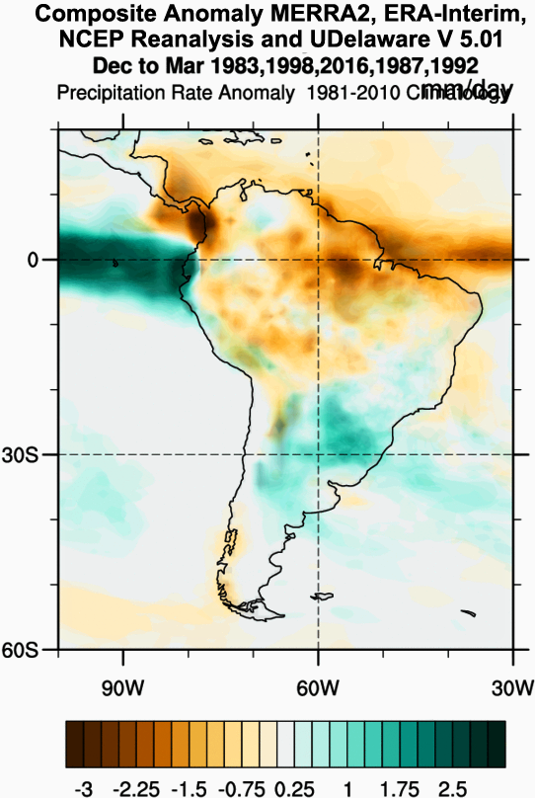
Warm ENSO Rainfall Anomalies

Slide 25
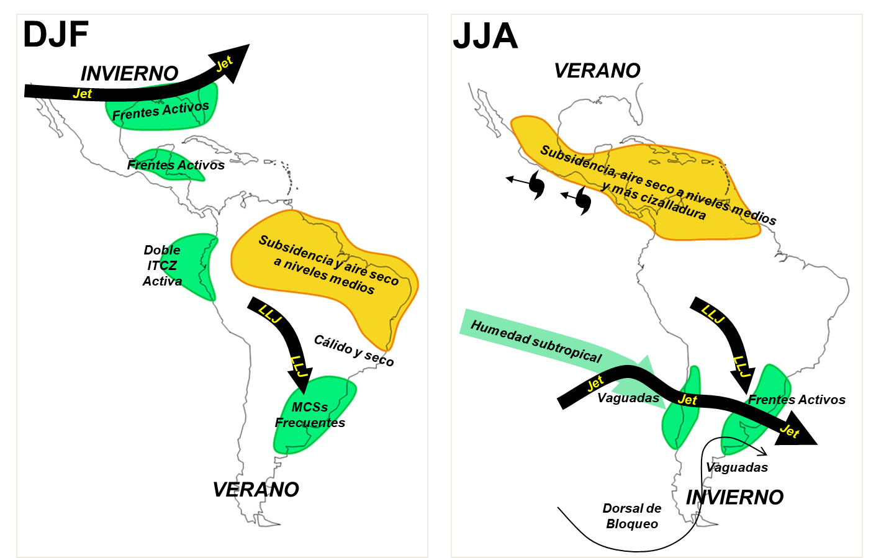
Warm ENSO Rainfall Anomalies

Slide 26
Poll Question #1
Which are generally true during La Niña? (1 or more)
a. More precipitation in NE South America
b. More precipitation in central Chile
c. More tropical cyclones in the Pacific
d. More tropical cyclones in the Caribbean
e. More precipitation in the Rio de La Plata region

Slide 27
Poll Question #1
Which are generally true during La Niña? (1 or more)
a. More precipitation in NE South America
b. More precipitation in central Chile
c. More tropical cyclones in the Pacific
d. More tropical cyclones in the Caribbean
e. More precipitation in the Rio de La Plata region

Slide 28
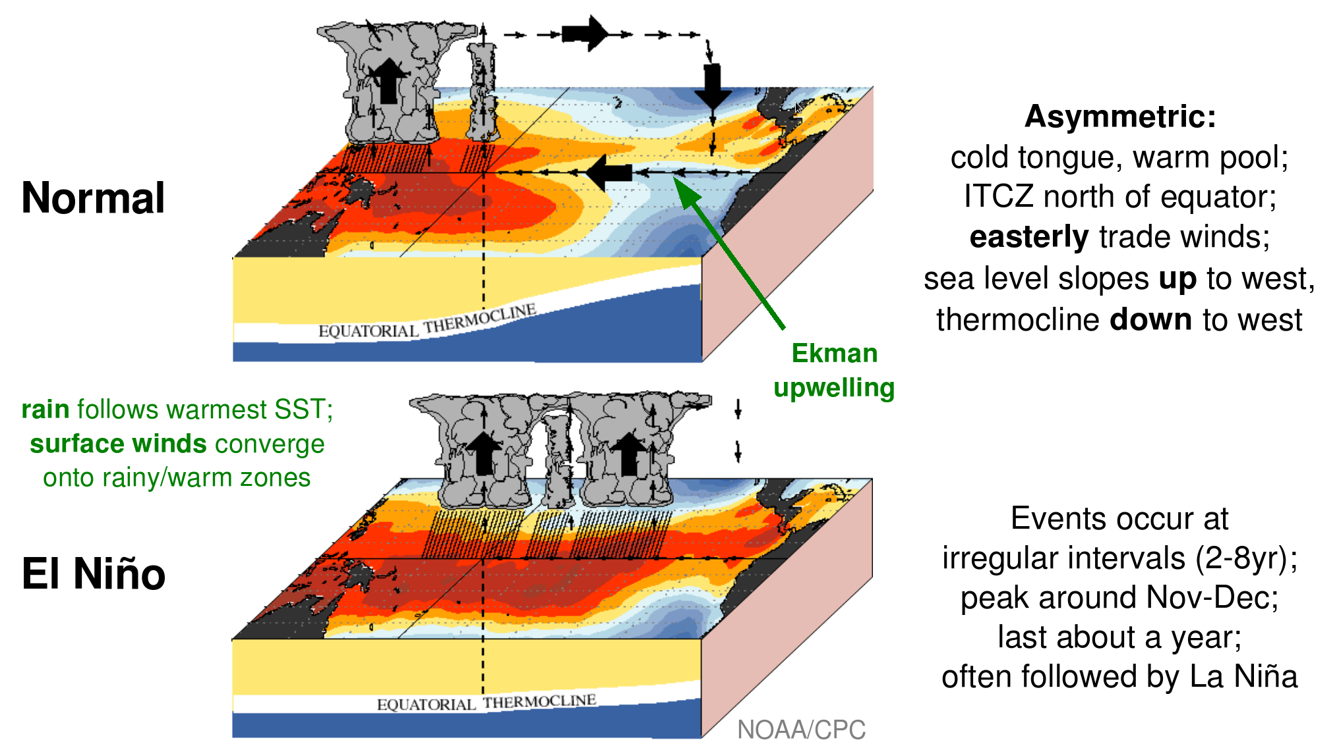
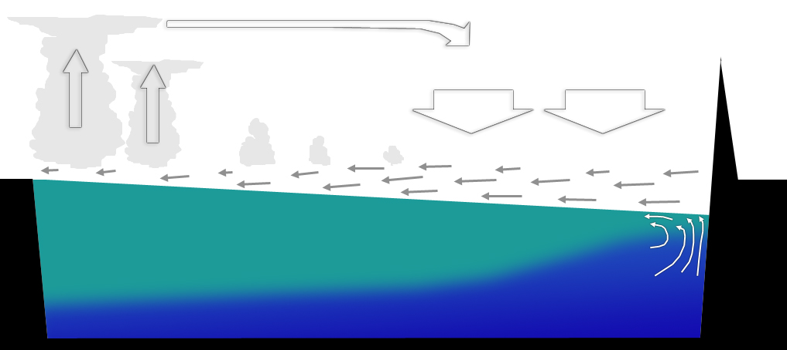
El Niño-Southern Oscillation (ENSO)
WARM WATERS
Easterly trades pile up warm water in the Western Pacific
COOL WATER
Trades transport cool waters from the south (Humboldt current) along South America, as well as cool waters from coastal upwelling. They favor equatorial upwelling.
Ramal subsidente de la circulación de Walker resalta estabilidad en el Pacífico oriental
WALKER CIRCULATION
Subsiding branch of the Walker circulation enhances stability over the Eastern Pacific
Ekman Upwelling
SEA LEVEL AND THERMOCLINE
Higher sea level and deeper thermocline in Western Pacific.
Indonesia
Higher sea level
Sudamérica
Warm Pool
Thermocline
Cool water
Notes:
https://www.climate.gov/enso

Slide 29
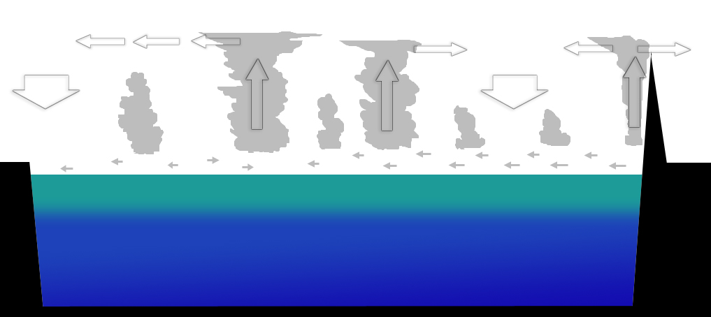
Warm ENSO
Normal: Asimetrías
Subsidencia Generalizada
Convección
Alisios fuertes
Nivel del mar alto
Afloramiento
Termoclina profunda
Subsidencia
Convección
Convección
Indonesia
Notes:
Referencia: CPC
29

Slide 30
Ocean-Atmospheric Coupling
Occurs via interactions between surface winds and the ocean surface:
Winds push currents
Currents redistribute water masses
The superficial temperature (SST) of water masses modifies atmospheric circulations
Notes:
https://www.climate.gov/enso

Slide 31
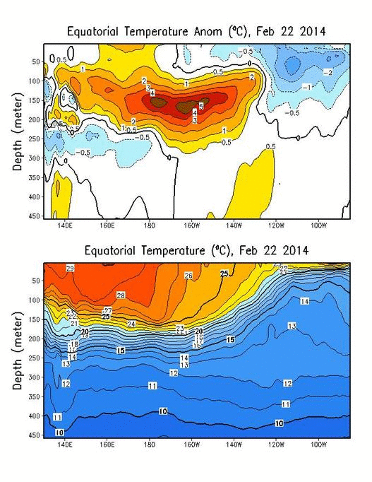
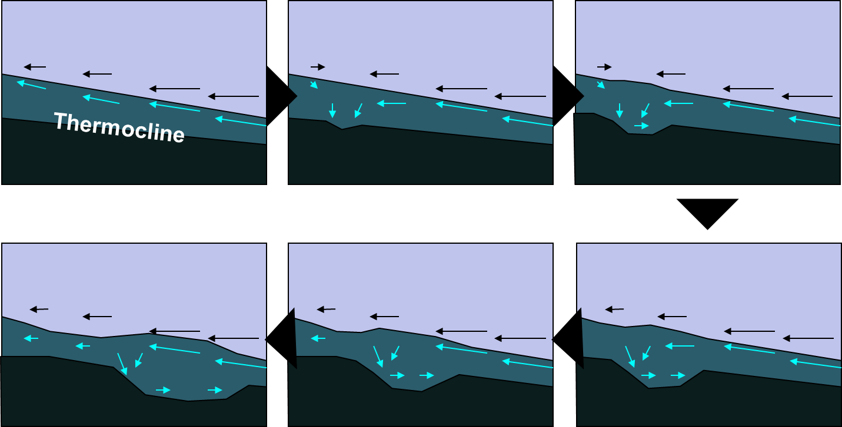
Oceanic Kelvin Wave Mechanism
Westerly wind bursts generate convergence when interacting with easterly trades
Currents converge too, and generate a perturbation that propagates eastward along the equator
This reflects in changes in sea-level and the depth of the thermocline.
Notes:
-La interacción entre el océano ecuatorial y la convección es un proceso estocástico.
-Para que ocurra interacción debe haber convección.
-Para que haya convección debe haber temperaturas suficientemente cálidas.
31

Slide 32
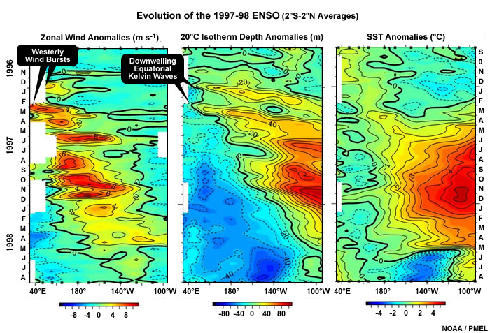
Evolution of the 1997 El Niño
Westerly wind bursts induce downwelling Kelvin Waves that reach the South American coast and warm up the ocean.
Currents distribute warm air masses westward.
Notes:
32

Slide 33
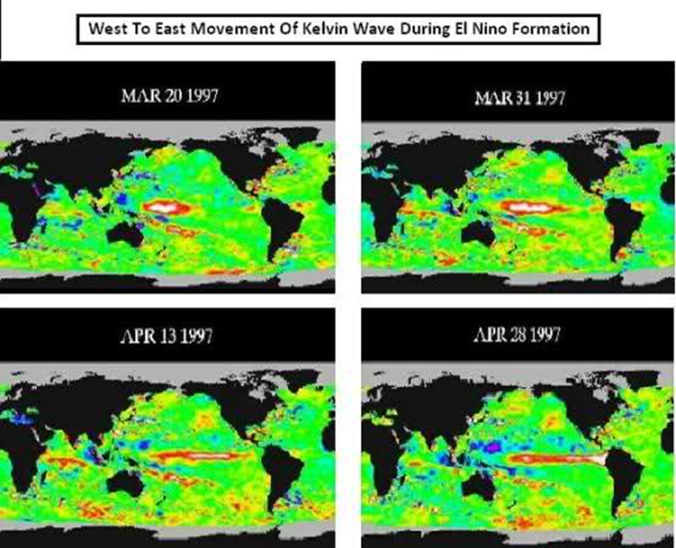
Kelvin Waves also reflect on sea level
Notes:
33

Slide 34
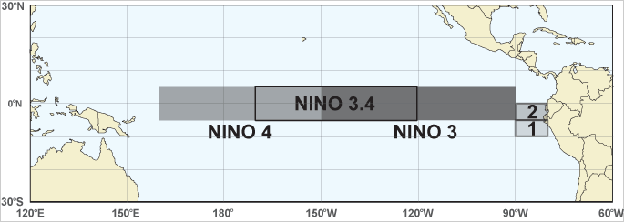
Classification and Monitoring
Niño 3.4:
Better predictability
More influence on global impacts
CPC/IRI use this region for monitoring and forecasting ENSO.
Niño 1+2:
Affects directly the South American Coast
Of special interest to Ecuador and Peru
Hard to predict
Notes:
https://www.climate.gov/enso

Slide 35
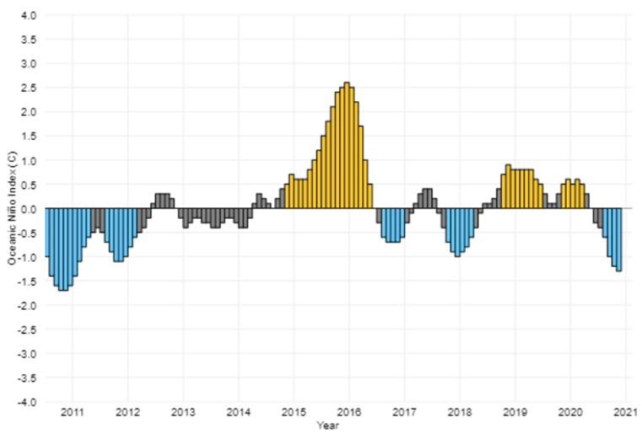
Oceanic Niño Index (ONI)
ONI Calculation:
ONI during the last 10 years
Average the Niño 3.4 region SST for each month.
Average it with values from the previous and following months.
This running three-month average is compared to a 30-year average.
Source: https://www.climate.gov/news-features/understanding-climate/climate-variability-oceanic-ni%C3%B1o-index

Slide 36
ENSO “Flavors”
Courtesy: Michelle L’Heureux.

Slide 37
ENSO Predictability
ONI Calculation:
Average the Niño 3.4 region SST for each month.
Average it with values from the previous and following months.
This running three-month average is compared to a 30-year average.
Source: https://www.climate.gov/news-features/understanding-climate/climate-variability-oceanic-ni%C3%B1o-index

Slide 38
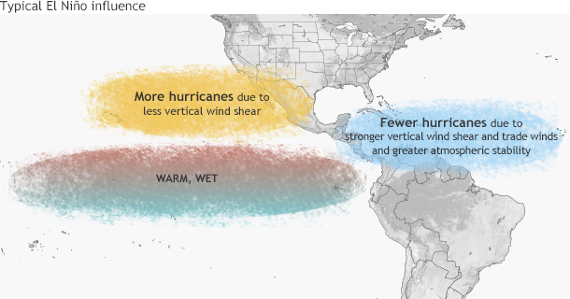
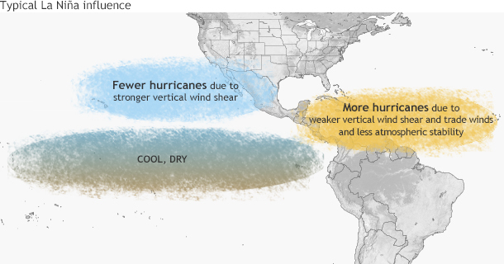
ENSO and Hurricanes
Great tool for Seasonal Forecasting around the Globe

Slide 39
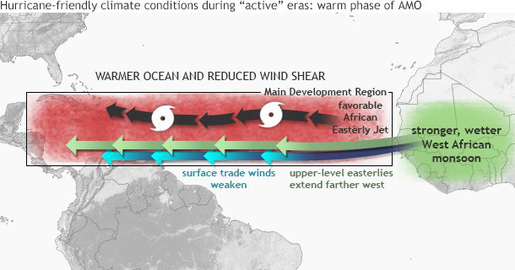
ENSO and Hurricanes in the Atlantic
Cool ENSO and Warm Atlantic Multidecadal Oscillation (AMO)
Warm phase of the AMO: Associates with warmer temperatures in the hurricane formation region
AMO: Goldenberg et al. 2001, Bell and Chelliah 2006.

Slide 40
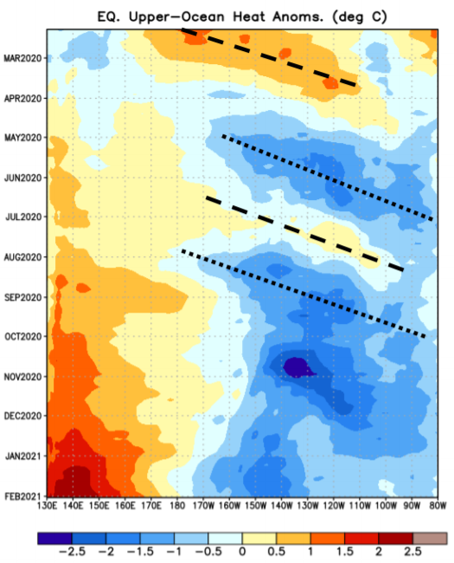
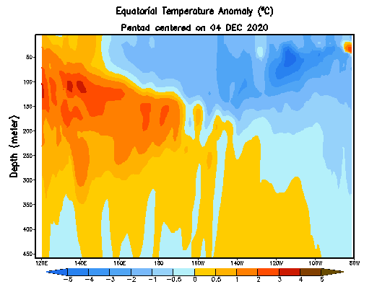
Current Conditions

Slide 41
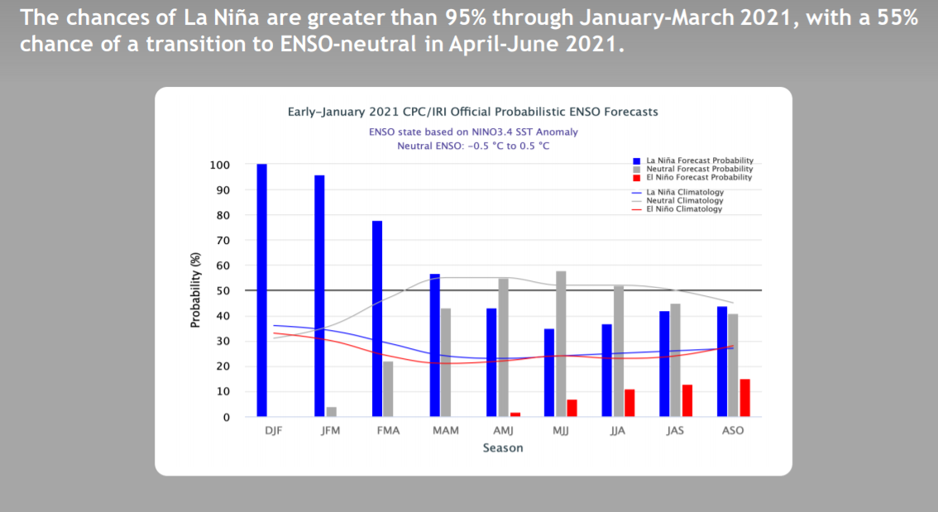
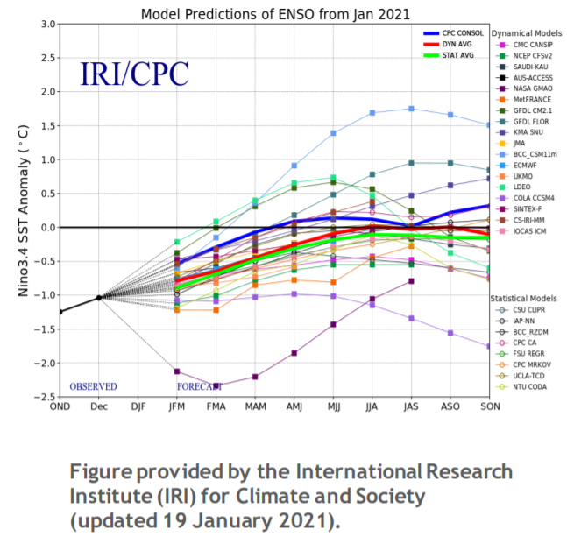
Current Forecasts

Slide 42
Poll Question #2
In which time of the year is ENSO less predictable? (pick 1)
a. Northern hemisphere summer
b. Northern hemisphere fall
c. Northern hemisphere winter
d. Northern hemisphere spring

Slide 43
Poll Question #2
In which time of the year is ENSO less predictable? (pick 1)
a. Northern hemisphere summer
b. Northern hemisphere fall
c. Northern hemisphere winter
d. Northern hemisphere spring

Slide 44
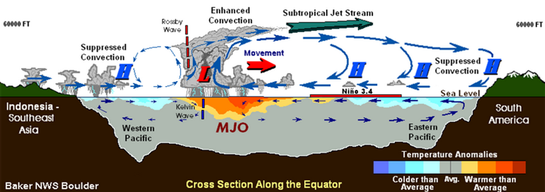
3. The Madden-Julian Oscillation (MJO)

Slide 45
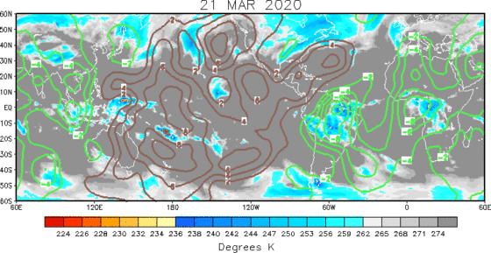
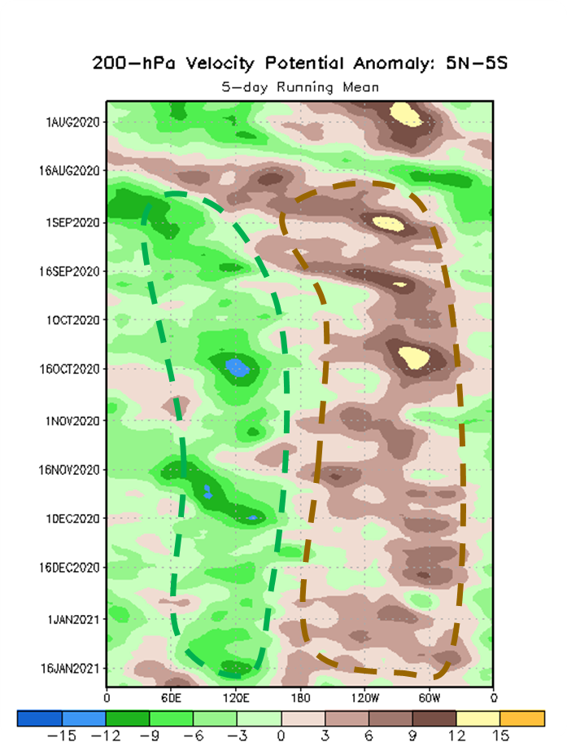
The MJO is discussed in the Monthly Sessions
Fig. 200 hPa Velocity Potential (green=divergent or wet, brown=convergent or dry) propagating from west to east from late March through late April of 2020. Source: CPC.
Fig. 200 hPa Velocity Potential Hovmoller diagram ►

Slide 46
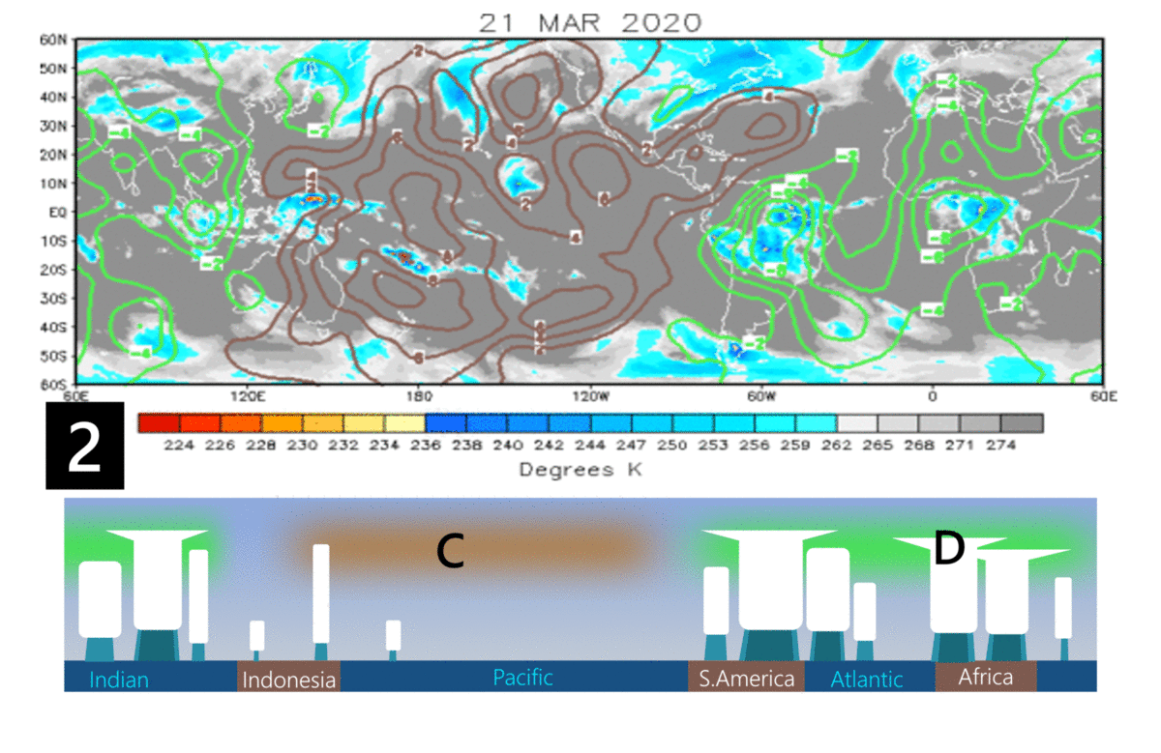
The Madden-Julian Oscillation (MJO)
200 hPa Velocity Potential and Brightness Temperature (convection)
Definition
Eastward moving disturbance of clouds, rainfall, winds, and pressure that traverses the planet in the tropics and returns to its initial starting point in ~30 to 60 days.
Intraseasonal tropical climate variability (i.e. varies on a week-to-week basis).
MJO PHASE
Convergent (C) / Divergent (D) and associated convection

Slide 47
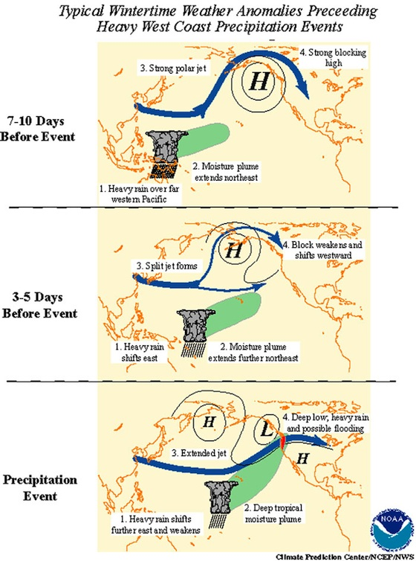
Importance of the MJO
Key for the variability of precipitation in the tropics.
  Upper divergent phase enhances deep convection and tropical cyclone intensity.
  Upper convergent phase enhances easterly trades and regions of orographic forcing (e.g. Eastern Costa Rica)
Affects the extra tropics too, via teleconnections (generation of Rossby Waves) and modulation of the subtropical jets.
West tier of upper divergent phase enhances tropical cyclogenesis (low-level westerlies and less shear).

Slide 48
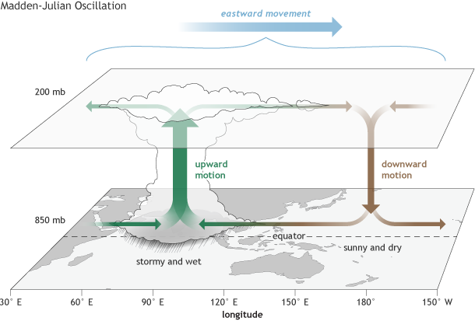
History of the MJO
It was first noticed by Dr. Roland Madden and Dr. Paul Julian in the early 1970s, when they were studying tropical wind and pressure patterns.
They noticed regular oscillations in winds between Singapore and Canton Island in the west central equatorial Pacific.
Reference: (Madden and Julian, 1971; 1972; Zhang, 2005).
Source: CPC.

Slide 49
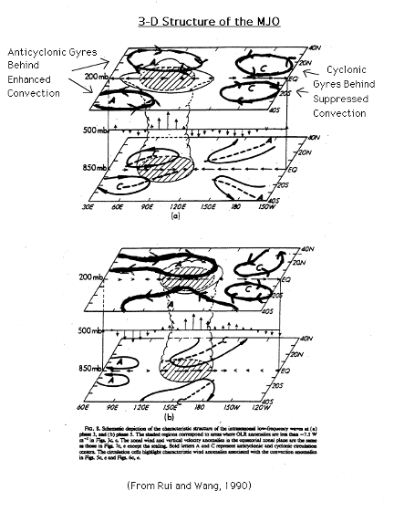
What triggers the MJO?
Strong convection that forms over warm equatorial waters (>27°C). Examples of triggers:
Latent heat release from strong convection generates gyres, symmetric to the equator, due to Geostrophic Adjustment
Tropospheric Kelvin Wave
Upper troughs/upper jets
Low-level westerly wind bursts
Mesoscale Convective System (MCS)
Dry air intrusions over ITCZ located away from the equator
Arriving MJO pulse, etc…
Surface gyres are opposite and weaker

Slide 50


Structure of the MJO
Most
Unstable
Column
Cyclonic Gyre
Source: Adames and Wallace (2015)

Slide 51

How does the MJO Propagate?
Propagates eastward.
Driven by equatorially trapped waves (Kelvin and Rossby waves) and by atmospheric-ocean coupling (AOC).
AOC: East of the convection…
Horizontal gyres favor upper divergence and ascent.
Subsidence and solar radiation favor surface warming, thus destabilization.
Propagation
Location favorable for new convection due AOC: EAST of the MJO convection
Sources: CPC, https://asr.science.energy.gov/news/thematic-highlights/post/6234
Notes:
One hypothesis is that heating and moistening provided by the distribution of cloud types (such as cirrus, stratocumulus, etc.)—or cloud populations—at different stages of the MJO is essential to its initiation and evolution.

Slide 52
Poll Question #3
What does the MJO convection produce in the upper troposphere, right over it? (1 or more)
a. A ridge
b. A trough
c. A perturbation in the tropopause
d. A warming (stabilizes the layer)

Slide 53
Poll Question #3
What does the MJO convection produce in the upper troposphere, right over it? (1 or more)
a. A ridge
b. A trough
c. A perturbation in the tropopause
d. A warming (stabilizes the layer)

Slide 54






Phases of the MJO

Slide 55
MJO Propagation
Evaluate:
200 hPa Velocity Potential and Brightness Temperature (convection)
Is propagation uniform?
No
What could cause anomalies in propagation?
Convection
Terrain
ENSO/SSTs
Synoptic features
Other atmospheric oscillations
MJO PHASE
Convergent (C) / Divergent (D) and associated convection

Slide 56
Poll Question #4
The upper convergent phase of the MJO associates with… (1 or more)
a. Weakening of the easterly trades
b. Acceleration of the easterly trades
c. Enhanced vertical wind shear in the Caribbean
d. Enhanced moisture convergence and rainfall in Eastern Costa Rica
e. Low-level westerlies

Slide 57
Poll Question #4
The upper convergent phase of the MJO associates with… (1 or more)
a. Weakening of the easterly trades
b. Acceleration of the easterly trades
c. Enhanced vertical wind shear in the Caribbean
d. Enhanced moisture convergence and rainfall in Eastern Costa Rica
e. Low-level westerlies

Slide 58



MJO Forecasts
We need to look for:
Is the MJO organized?
What is its current propagation speed?
  How long it takes to go around the globe?
What phase is the MJO at?
Consider Different models
  Weight to models that have been resolving the MJO best, and that are coherent with the expected propagation.

Slide 59



Forecasting the MJO
4. Consider Different Models

Slide 60

Forecasting the MJO
Phase Diagram
Not often shown in the Monthly Sessions due to time limitations and complex interpretation.
Provides insight on MJO Phase and degree of organization:
a) Inside circle: disorganized
b) Outside the circle: Organized
c) Numbers are the MJO Phase
Resource: https://www.cpc.ncep.noaa.gov/products/precip/CWlink/MJO/CLIVAR/clivar_wh.shtml#for

Slide 61
MJO Resources
NOAA’s Climate Prediction Center MJO page:
https://www.cpc.ncep.noaa.gov/products/precip/CWlink/MJO/mjo.shtml
Some MJO References
Madden R. and P. Julian, 1971: Detection of a 40-50 day oscillation in the zonal wind in the tropical Pacific, J. Atmos. Sci., 28, 702-708.
Madden R. and P. Julian, 1972: Description of global-scale circulation cells in the tropics with a 40-50 day period. J. Atmos. Sci., 29, 1109-1123.
https://www.climate.gov/news-features/blogs/enso/what-mjo-and-why-do-we-care

Slide 62
Poll Question #5
What tier of the MJO favors tropical cyclogenesis in the Americas the most? (pick 1)
a. Center tier of the upper divergent phase
b. Center tier of the upper convergent phase
c. Eastern tier of the upper divergent phase
d. Western tier of the upper divergent phase

Slide 63
Poll Question #5
What tier of the MJO favors tropical cyclogenesis in the Americas the most? (pick 1)
a. Center tier of the upper divergent phase
b. Center tier of the upper convergent phase
c. Eastern tier of the upper divergent phase
d. Western tier of the upper divergent phase

Slide 64

Equatorial Tropospheric Perturbations

Slide 65

Equatorial Tropospheric Perturbations
Wheeler and Weickmann (2001) developed a method for filtering OLR in real-time to identify, track, and predict the MJO and equatorial waves.

Slide 66
Poll Question #6
Which system propagates faster? (pick one)
a. Oceanic Kelvin Wave
b. The MJO
c. Tropospheric Kelvin Wave
d. Tropical Waves

Slide 67
Poll Question #6
Which system propagates faster? (pick one)
a. Oceanic Kelvin Wave
b. The MJO
c. Tropospheric Kelvin Wave
d. Tropical Waves

Slide 68
Poll Question #7
What increases the risk of a hurricane becoming strong? (1 or more)
a. Divergent phase of the MJO
b. Deep-layer warm anomalies in the ocean
c. Reduced vertical shear
d. High precipitable water/column moisture
e. A large circulation

Slide 69
Poll Question #7
What increases the risk of a hurricane becoming strong? (1 or more)
a. Divergent phase of the MJO
b. Deep-layer warm anomalies in the ocean
c. Reduced vertical shear
d. High precipitable water/column moisture
e. A large circulation

